Slide 1



Gene expression analysis for fatal and dangerous disease prediction.
November 2020

Slide 2
ShahnovIch Pavel
FINAL PROJECT

Slide 3
DATABASE:E-MTAB-3732 - A comprehensive human expression map SOURCE:Array Express EMBL-EBI.

Slide 4
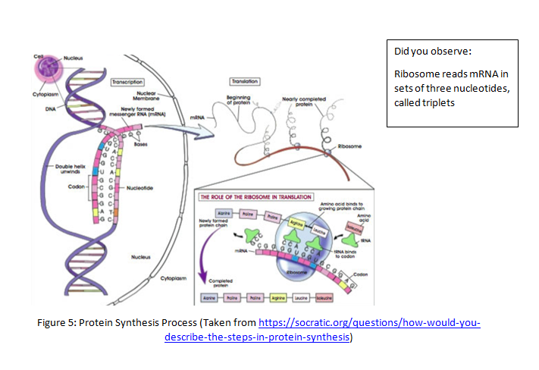
Expression levels in transcription and translation processes

Slide 5
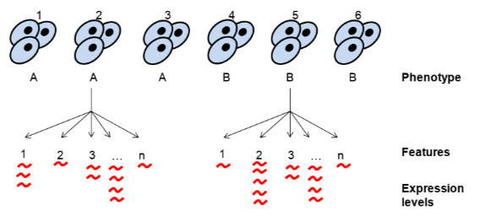
A and B-disease type or norm,1,2,3,4,5,6-gene names.

Slide 6
General description of the data: Human expression map dataset includes 27887 samples of healthy or sick patients ,each sample is described by material type, organism, organism part, disease type, clinical history, genotype, phenotype, technology type….and by gene expression values for 50000 genes approximately. Total data size before reduction- 24 gb. Project goal-prediction of cancer type(type of disease) based on gene expression test results during biochemical supervised learning diagnostics.

